Slide 1
THE LIFE OF CHRIST
PART 69

Slide 2
Luke 18:1 Then He spoke a parable to them, that men always ought to pray and not lose heart, ² saying: "There was in a certain city a judge who did not fear God nor regard man. ³ "Now there was a widow in that city; and she came to him, saying, 'Get justice for me from my adversary.' ⁴ "And he would not for a while; but afterward he said within himself, 'Though I do not fear God nor regard man, ⁵ 'yet because this widow troubles me I will avenge her, lest by her continual coming she weary me.' " ⁶ Then the Lord said, "Hear what the unjust judge said. ⁷ "And shall God not avenge His own elect who cry out day and night to Him, though He bears long with them? ⁸ "I tell you that He will avenge them speedily. Nevertheless, when the Son of Man comes, will He really find faith on the earth?"

Slide 3
James 5:13 Is anyone among you suffering? Let him pray.

Slide 4
1 Peter 5:6 Therefore humble yourselves under the mighty hand of God, that He may exalt you in due time, ⁷ casting all your care upon Him, for He cares for you.

Slide 5
Luke 18:2 "There was in a certain city a judge who did not fear God nor regard man.

Slide 6
Deuteronomy 16:18 " You shall appoint judges and officers in all your gates, which the LORD your God gives you, according to your tribes, and they shall judge the people with just judgment. ¹⁹ "You shall not pervert justice; you shall not show partiality, nor take a bribe, for a bribe blinds the eyes of the wise and twists the words of the righteous. ²⁰ "You shall follow what is altogether just, that you may live and inherit the land which the LORD your God is giving you.

Slide 7
Luke 18:3 "Now there was a widow in that city; and she came to him, saying, 'Get justice for me from my adversary.' ⁴ "And he would not for a while; but afterward he said within himself, 'Though I do not fear God nor regard man, ⁵ 'yet because this widow troubles me I will avenge her, lest by her continual coming she weary me.' "

Slide 8
weary means: 1. to blacken an eye, give a black eye, strike in the face
2. to bring someone to submission by constant annoyance, wear down

Slide 9
Luke 18:6 Then the Lord said, "Hear what the unjust judge said. ⁷ "And shall God not avenge His own elect who cry out day and night to Him, though He bears long with them? ⁸ "I tell you that He will avenge them speedily. Nevertheless, when the Son of Man comes, will He really find faith on the earth?"

Slide 10
1 John 5:14 Now this is the confidence that we have in Him, that if we ask anything according to His will, He hears us. ¹⁵ And if we know that He hears us, whatever we ask, we know that we have the petitions that we have asked of Him.

Slide 11
Matthew 6:7 "And when you pray, do not use vain repetitions as the heathen do. For they think that they will be heard for their many words. ⁸ "Therefore do not be like them. For your Father knows the things you have need of before you ask Him.

Slide 12
James 1:5 If any of you lacks wisdom, let him ask of God, who gives to all liberally and without reproach, and it will be given to him. ⁶ But let him ask in faith, with no doubting, for he who doubts is like a wave of the sea driven and tossed by the wind. ⁷ For let not that man suppose that he will receive anything from the Lord; ⁸ he is a double-minded man, unstable in all his ways.

Slide 13
2 Thessalonians 1:7 and to give you who are troubled rest with us when the Lord Jesus is revealed from heaven with His mighty angels, ⁸ in flaming fire taking vengeance on those who do not know God, and on those who do not obey the gospel of our Lord Jesus Christ. ⁹ These shall be punished with everlasting destruction from the presence of the Lord and from the glory of His power, ¹⁰ when He comes, in that Day, to be glorified in His saints and to be admired among all those who believe, because our testimony among you was believed.

Slide 14
Romans 8:28 And we know that all things work together for good to those who love God, to those who are the called according to His purpose.

Slide 15
Luke 18:9 Also He spoke this parable to some who trusted in themselves that they were righteous, and despised others: ¹⁰ "Two men went up to the temple to pray, one a Pharisee and the other a tax collector. ¹¹ "The Pharisee stood and prayed thus with himself, 'God, I thank You that I am not like other men -- extortioners, unjust, adulterers, or even as this tax collector. ¹² 'I fast twice a week; I give tithes of all that I possess.' ¹³ "And the tax collector, standing afar off, would not so much as raise his eyes to heaven, but beat his breast, saying, 'God, be merciful to me a sinner!' ¹⁴ "I tell you, this man went down to his house justified rather than the other; for everyone who exalts himself will be humbled, and he who humbles himself will be exalted."

Slide 16
Psalm 55:17 Evening and morning and at noon I will pray, and cry aloud, And He shall hear my voice.

Slide 17
1st hour of prayer - 9 a.m. our time, = 3rd hour Acts 2:15.
2nd hour of prayer - noon our time, = 6th hour.
3rd hour of prayer - 3 p.m. our time = 9th hour Acts 3:1, 10:30.

Slide 18
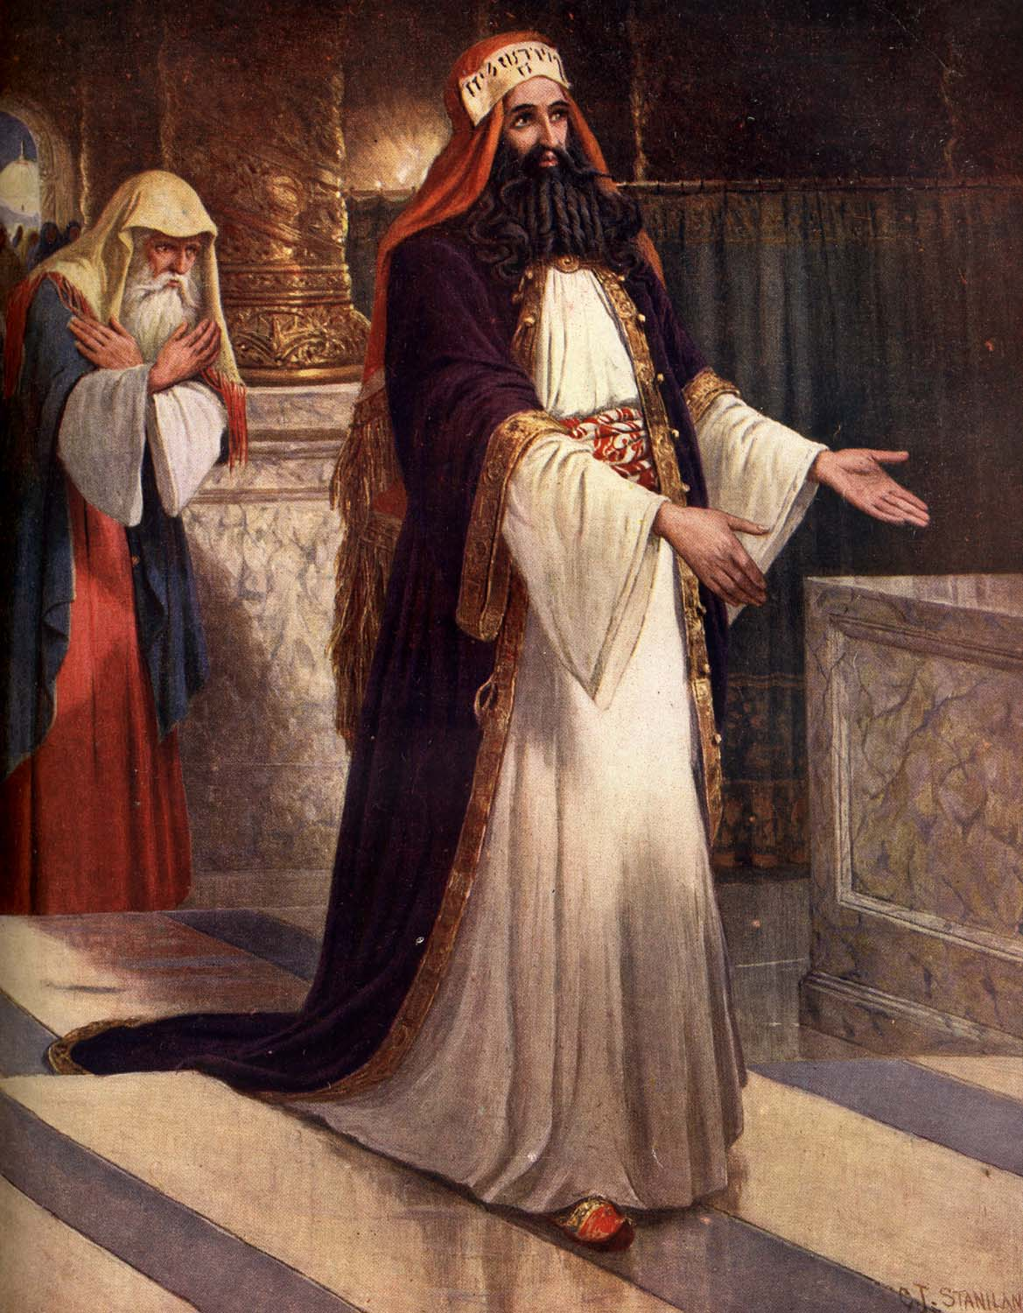

Slide 19
Matthew 15:3 He answered and said to them, "Why do you also transgress the commandment of God because of your tradition? ⁴ "For God commanded, saying, 'Honor your father and your mother'; and, 'He who curses father or mother, let him be put to death.' ⁵ "But you say, 'Whoever says to his father or mother, "Whatever profit you might have received from me is a gift to God" -- ⁶ 'then he need not honor his father or mother.' Thus you have made the commandment of God of no effect by your tradition. ⁷ "Hypocrites! Well did Isaiah prophesy about you, saying: ⁸ 'These people draw near to Me with their mouth, And honor Me with their lips, But their heart is far from Me. ⁹ And in vain they worship Me, Teaching as doctrines the commandments of men.' "

Slide 20
Luke 18:11 "The Pharisee stood and prayed thus with himself, 'God, I thank You that I am not like other men -- extortioners, unjust, adulterers, or even as this tax collector. ¹² 'I fast twice a week; I give tithes of all that I possess.'

Slide 21
Romans 12:3 For I say, through the grace given to me, to everyone who is among you, not to think of himself more highly than he ought to think, but to think soberly, as God has dealt to each one a measure of faith.
2 Corinthians 10:12 For we dare not class ourselves or compare ourselves with those who commend themselves. But they, measuring themselves by themselves, and comparing themselves among themselves, are not wise.

Slide 22
Luke 18:13 "And the tax collector, standing afar off, would not so much as raise his eyes to heaven, but beat his breast, saying, 'God, be merciful to me a sinner!'

Slide 23
1 John 1:7 But if we walk in the light as He is in the light, we have fellowship with one another, and the blood of Jesus Christ His Son cleanses us from all sin. ⁸ If we say that we have no sin, we deceive ourselves, and the truth is not in us. ⁹ If we confess our sins, He is faithful and just to forgive us our sins and to cleanse us from all unrighteousness. ¹⁰ If we say that we have not sinned, we make Him a liar, and His word is not in us.

Slide 24
Luke 18:14 "I tell you, this man went down to his house justified rather than the other; for everyone who exalts himself will be humbled, and he who humbles himself will be exalted."

Slide 25
1 Peter 5:5 Likewise you younger people, submit yourselves to your elders. Yes, all of you be submissive to one another, and be clothed with humility, for "God resists the proud, But gives grace to the humble." ⁶ Therefore humble yourselves under the mighty hand of God, that He may exalt you in due time, ⁷ casting all your care upon Him, for He cares for you.
Matthew 18:4 "Therefore whoever humbles himself as this little child is the greatest in the kingdom of heaven.

Slide 26
Philippians 2:3 Let nothing be done through selfish ambition or conceit, but in lowliness of mind let each esteem others better than himself. ⁴ Let each of you look out not only for his own interests, but also for the interests of others. ⁵ Let this mind be in you which was also in Christ Jesus, ⁶ who, being in the form of God, did not consider it robbery to be equal with God, ⁷ but made Himself of no reputation, taking the form of a bondservant, and coming in the likeness of men. ⁸ And being found in appearance as a man, He humbled Himself and became obedient to the point of death, even the death of the cross. ⁹ Therefore God also has highly exalted Him and given Him the name which is above every name,

Slide 27
Luke 17:10 "So likewise you, when you have done all those things which you are commanded, say, 'We are unprofitable servants. We have done what was our duty to do.' "

